Slide 1
5 RELUCTANT HEROES

Slide 2
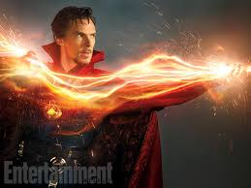
RELUCTANT DOCTOR STRANGE

Slide 3
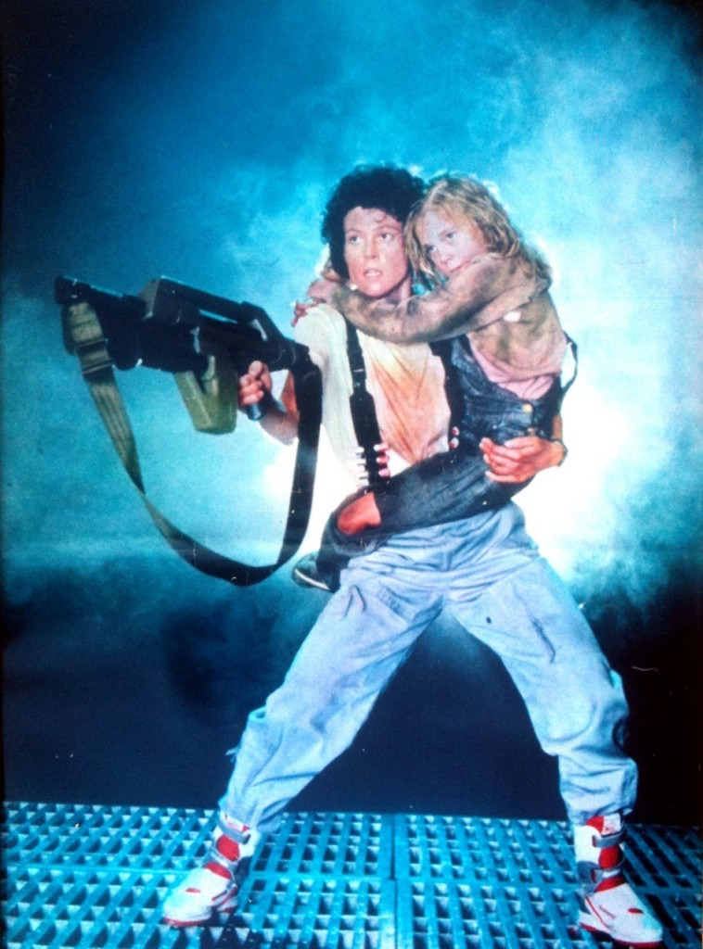
RELUCTANT RIPLEY

Slide 4
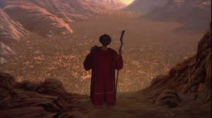
RELUCTANT MOSES

Slide 5
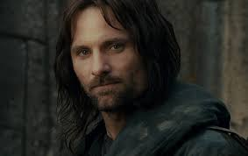
RELUCTANT ARAGORN

Slide 6
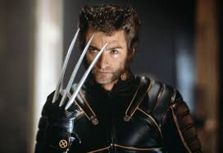
RELUCTANT WOLVERINE

